Slide 1
CRYPTO BROS
ROBO FORECASTER
Group 1 (aka Crypto Bros):
Diego, Hamza, Santiago, Travis

Slide 2
About Us
Group Members
Diego
Hamza
Santiago
Travis
Github Repository
https://github.com/santiago-pesantez/Project-2
Crypto Bros Robo Forecaster
https://facebook.com/crypto.bros.robo.forecaster
https://m.me/crypto.bros.robo.forecaster

Slide 3
Crypto Bros
Robo Forecaster Overview
The Crypto Bros Robo Advisor is a publicly accessible Facebook Messenger Robo Advisor which uses sentiment analysis of Twitter data and machine learning to forecast predictions on the price and profits of the user’s desired cryptocurrency.
Notes:
Travis was here

Slide 4
Technologies
Front End
Facebook Messenger Chat Bot
Back End
AWS Lex AWS Lambda Twitter Sentiment Analysis App Facebook Prophet Forecasting

Slide 5
Front End

Slide 6


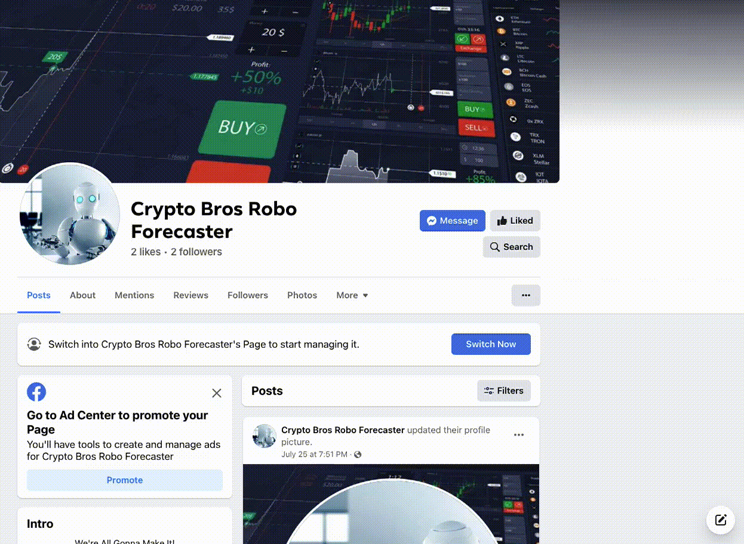
Facebook Chat Bot
Created Facebook Page
Created Facebook App
Facebook App supplies AWS with user input via postback request to AWS
Back End handles all input and generates output
Output is returned to Facebook App which gets sent to the user

Slide 7
Back End

Slide 8
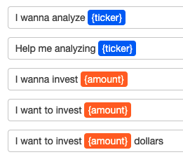
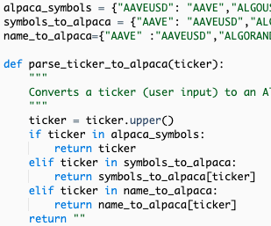
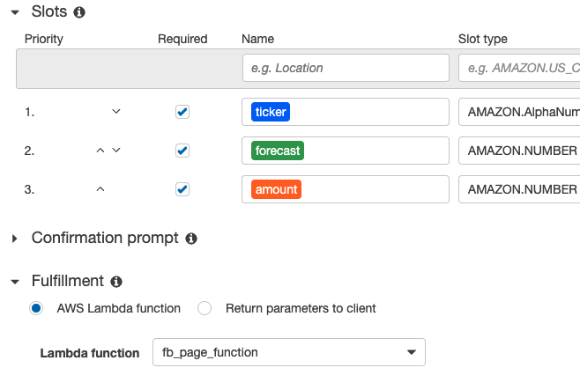
AWS Lex and Lambda
Created Lex Bot with utterances to detect user intentions
Assigns user input to variable slots
Submits input to Lambda for validation and fulfillment
Lambda validates the input from the user
Lambda passes user’s chosen crypto symbol to Twitter sentiment analysis function
Lambda calls fbprophet forecasting function

Slide 9
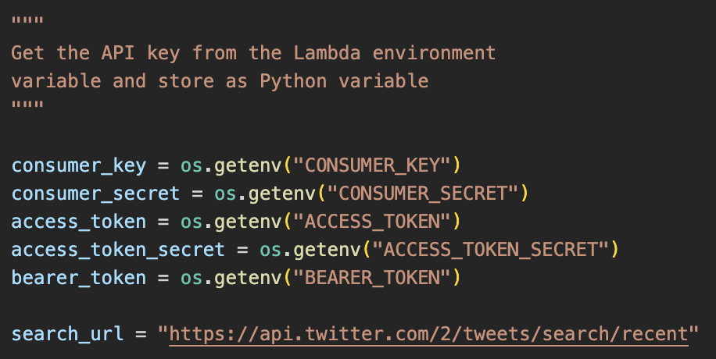

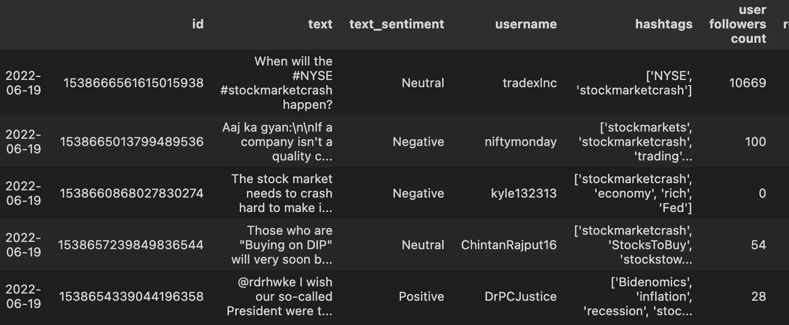
Twitter Sentiment Analysis
Retrieves Twitter API tokens from Lambda environment
Receives input from user on desired cryptocurrency ticker
Searches recent Tweets which contain the crypto symbol
Analyzes Tweet for Positive, Neutral, or Negative sentiment
Passes resulting dataframe to Facebook Prophet for forecasting

Slide 10
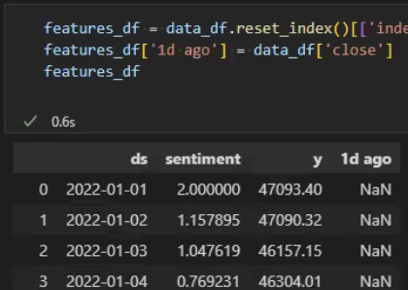

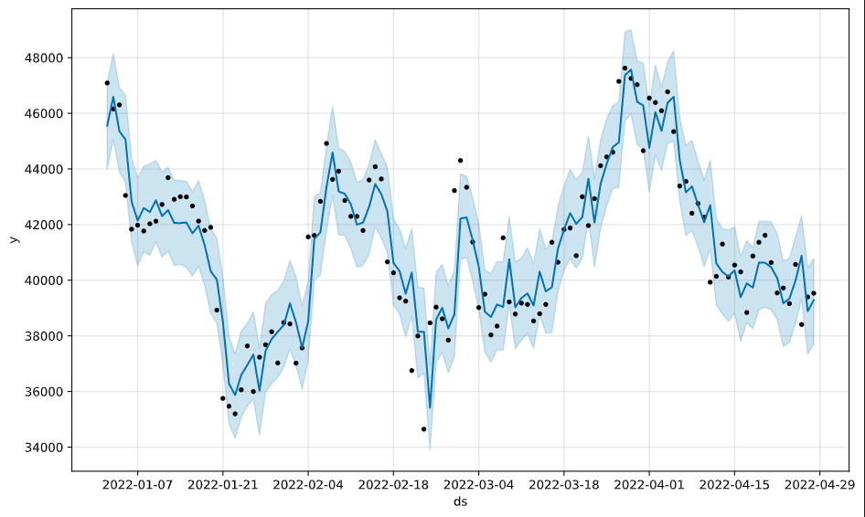
Facebook Prophet Forecasting
Retrieves Alpaca API tokens from Lambda environment
Receives output from Twitter Sentiment Analysis
Obtains current price of crypto via Alpaca API
Forecasts crypto price with incredible precision and accuracy
Feeds results back through Lambda and Lex to Facebook Chat Bot

Slide 11
LIVE DEMO
https://www.facebook.com/crypto.bros.robo.forecaster
https://m.me/crypto.bros.robo.forecaster

Slide 12
Questions?

